Slide 1
Digital Portfolio
STUDENT NAME: PRASANNA A
REGISTER NO AND NMID: D49AD9BC43A3617A63A4E375C41454C8
DEPARTMENT: BSC COMPUTER SCIENCE
COLLEGE: VOORHEES COLLEGE

Slide 2
PROJECT TITLE
DIGITAL PORTFOLIO

Slide 3


AGENDA
Problem Statement
Project Overview
End Users
Tools and Technologies
Portfolio design and Layout
Features and Functionality
Results and Screenshots
Conclusion
Github Link
3/21/2024 Annual Review

Slide 4

PROBLEM STATEMENT
Many students and professionals lack a well-structured online presence. A traditional resume often fails to showcase skills, creativity, and projects interactively. There is a need for a digital portfolio that highlights personal achievements, projects, and technical expertise in an attractive way.

Slide 5

PROJECT OVERVIEW
This portfolio project is a personal website designed using HTML, CSS, and JavaScript.
It showcases:
Personal introduction & profile
Academic and technical skills
Projects and achievements
Contact form for communication

Slide 6

WHO ARE THE END USERS?
Recruiters & Hiring Managers
College/University Evaluators
Clients looking for developers/designers
Networking peers in the tech community

Slide 7

TOOLS AND TECHNIQUES
HTML5 – for structure
CSS3 – for styling & responsive design
JavaScript – for interactivity
Visual Studio Code – IDE
GitHub – version control & hosting

Slide 8
PORTFOLIO DESIGN AND LAYOUT
Clean, modern design with cursive fonts and colourful theme
Circular profile picture at the top
Navigation menu (About, Projects, Contact)
Interactive project cards with hover effects
Responsive layout for mobile & desktop
8

Slide 9
FEATURES AND FUNCTIONALITY
Attractive & user-friendly interface
Highlighted skills and achievements
Project showcase with descriptions
Contact form with validation
Smooth animations and hover effects

Slide 10

RESULTS AND SCREENSHOTS
(Add screenshots of your portfolio website here)
Homepage with circular profile photo
About section with personal details
Projects page/cards
Contact form submission success message
3/21/2024 Annual Review
10

Slide 11
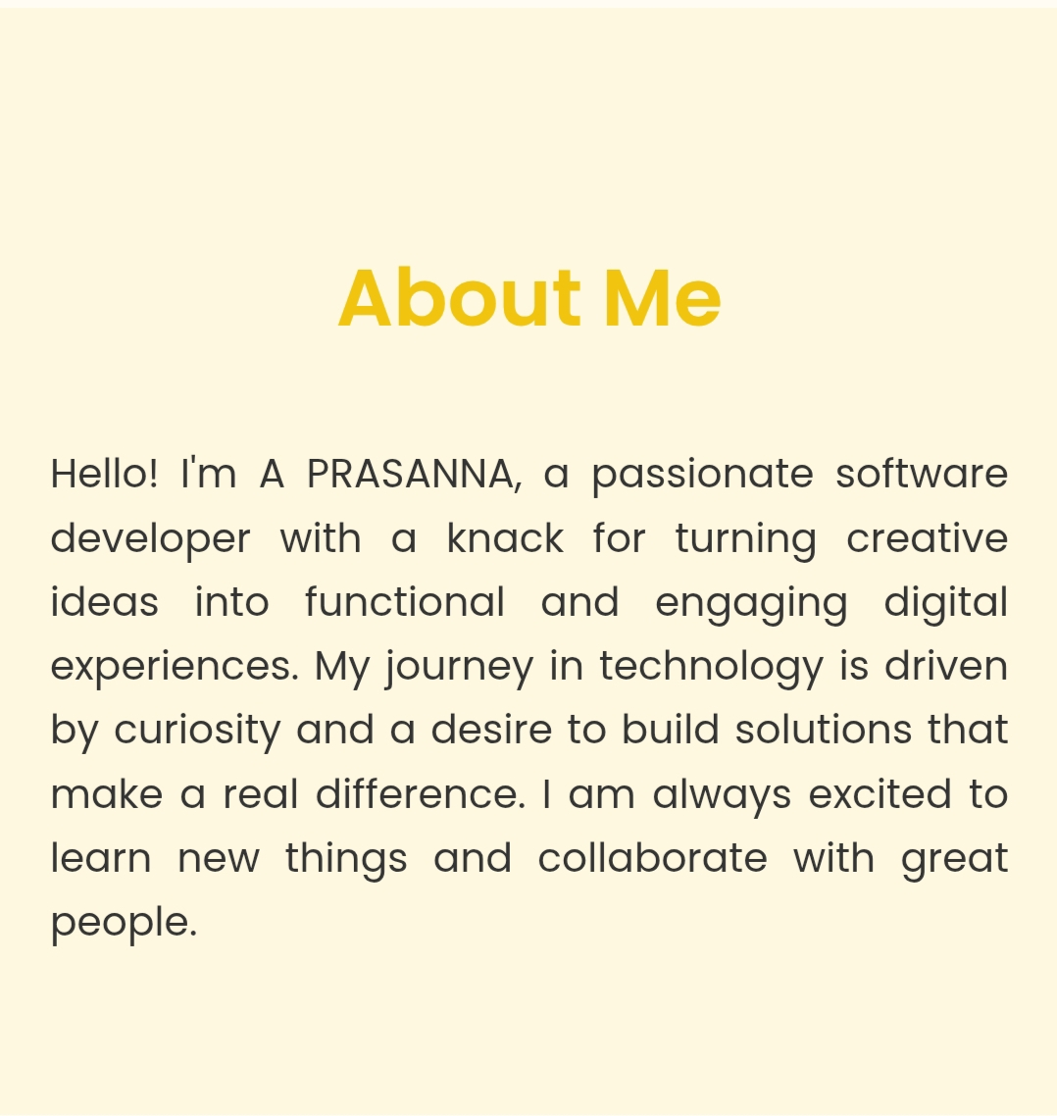
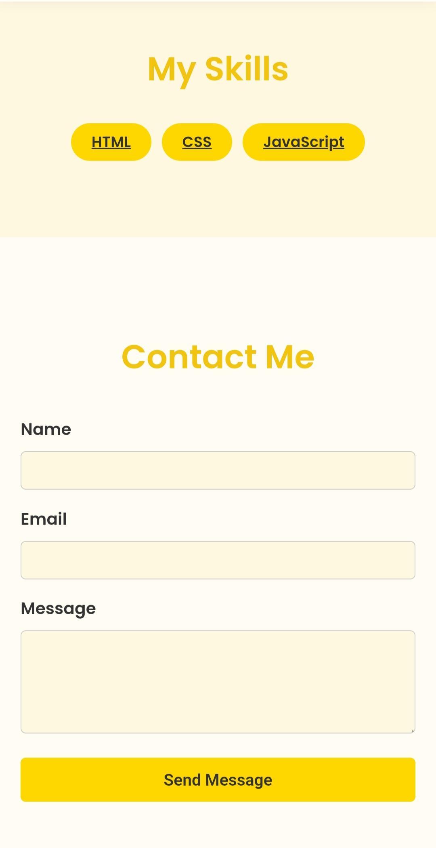
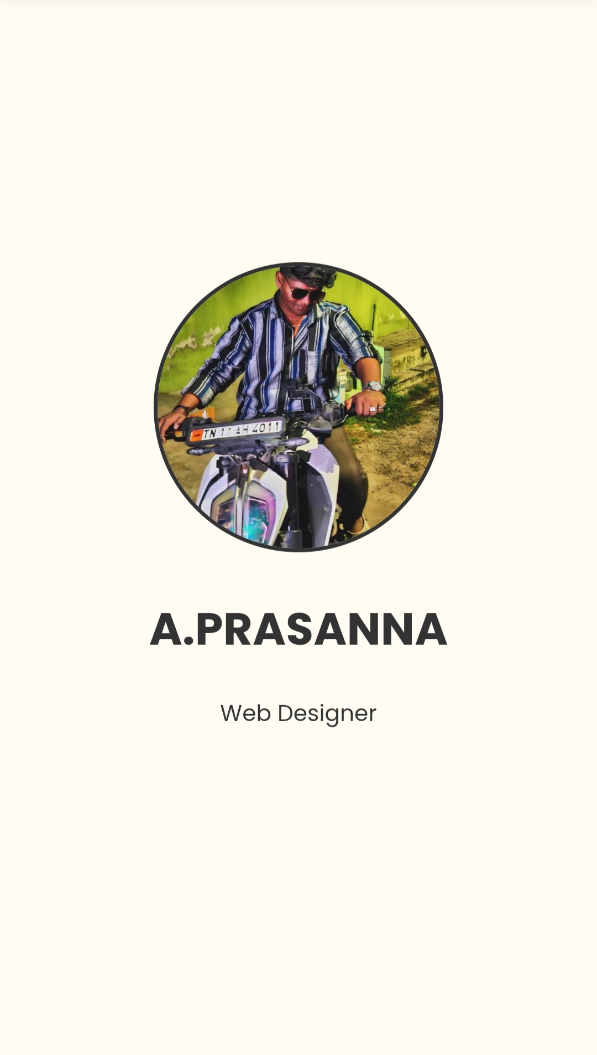

Slide 12
CONCLUSION
The portfolio provides a dynamic alternative to a traditional resume.
it:
Improves professional visibility
Highlights technical skills interactively
Acts as a personal brand identity online
Can be expanded with more projects and blog sections
12

Slide 13
THANK YOU

